Slide 1
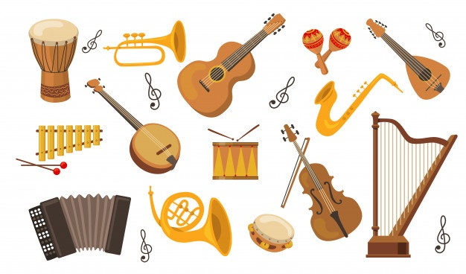
MUSICAL INSTRUMENTS
Muzički instrumenti

Slide 2
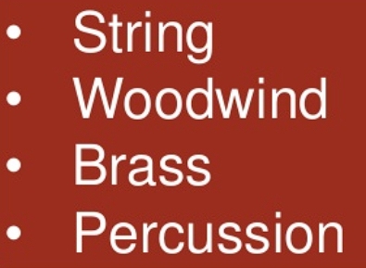

Slide 3
String instruments have strings on which to play.
strings

Slide 5
Do you know of 2 cellos?
https://www.youtube.com/watch?v=D9LrEXF3USs
https://www.youtube.com/watch?v=qGKqkwarK2o

Slide 11
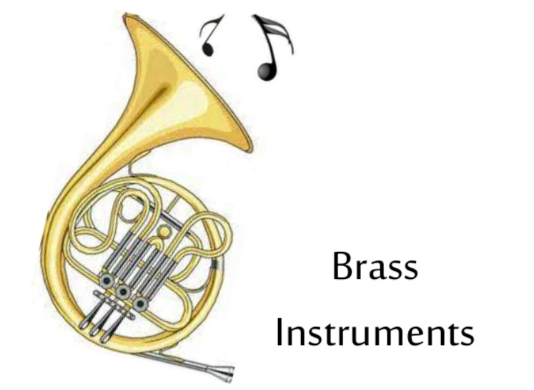

Slide 12
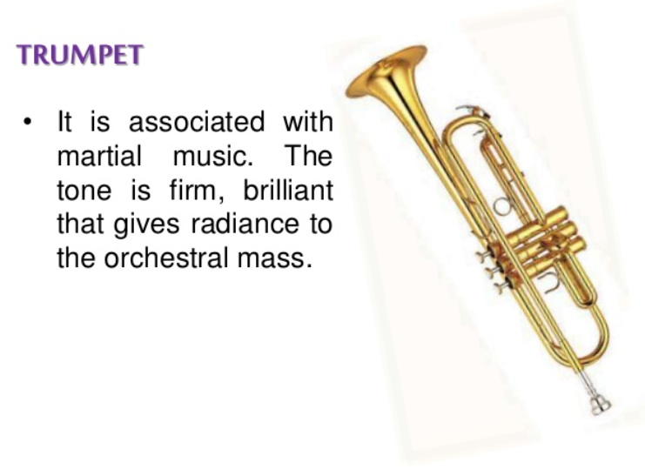
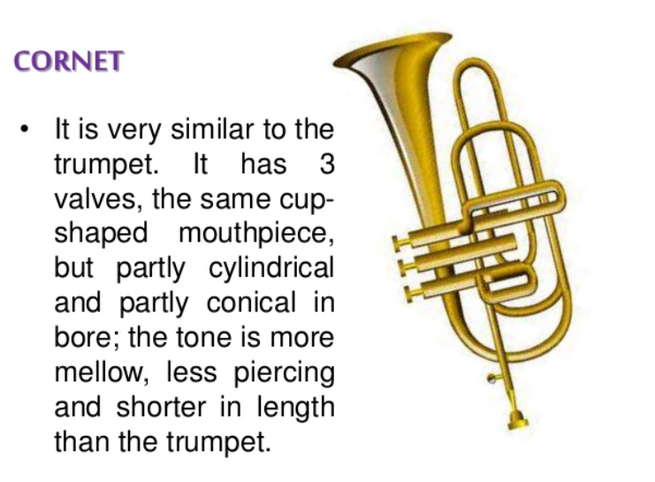

Slide 13
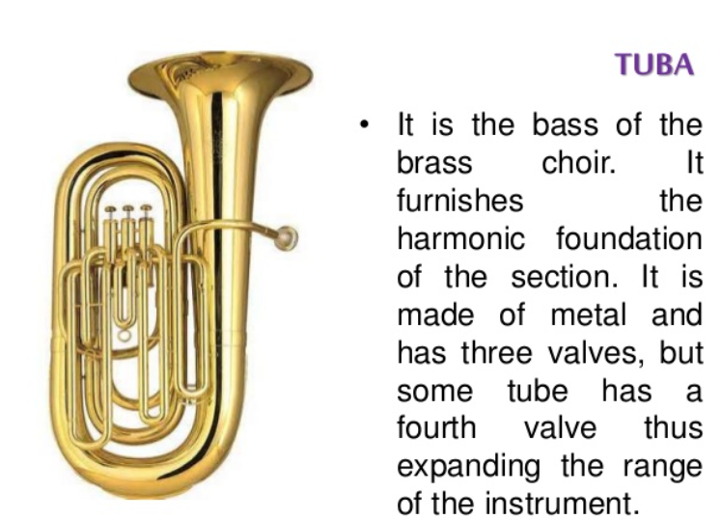
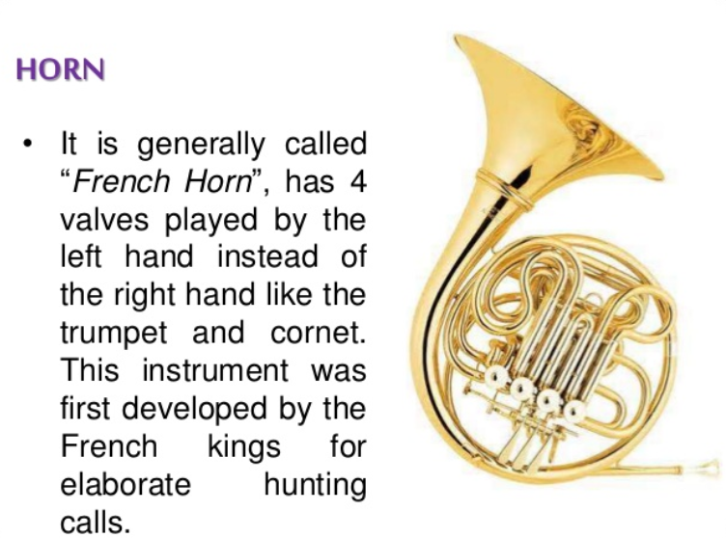

Slide 15
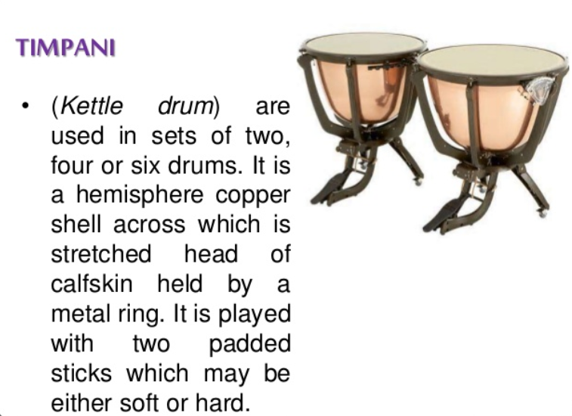

Slide 17
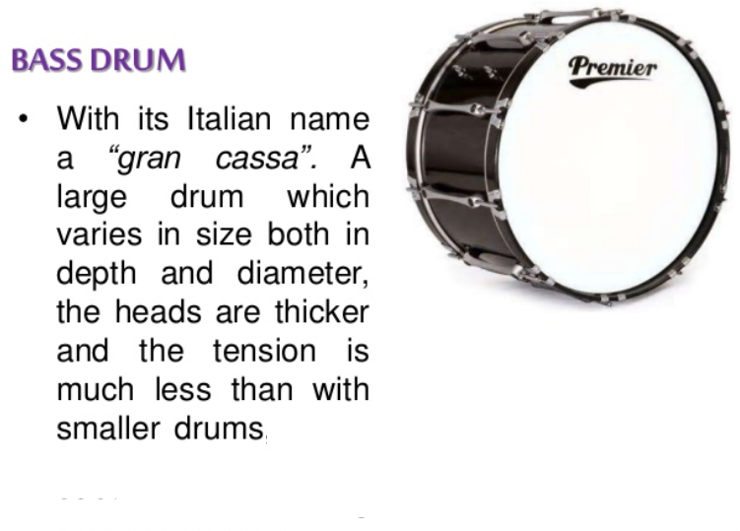

Slide 18
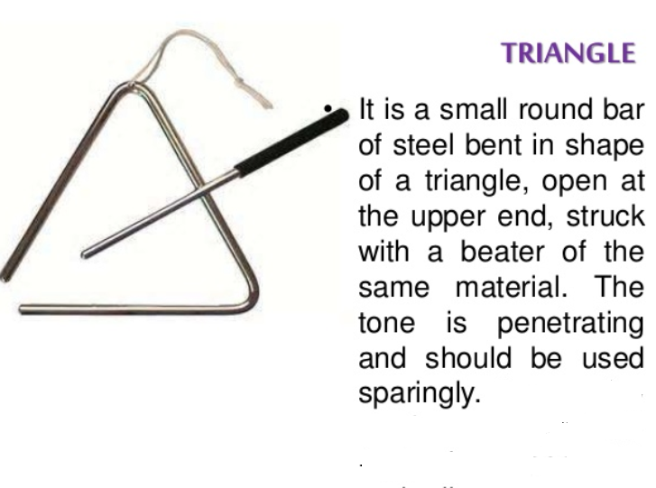

Slide 19
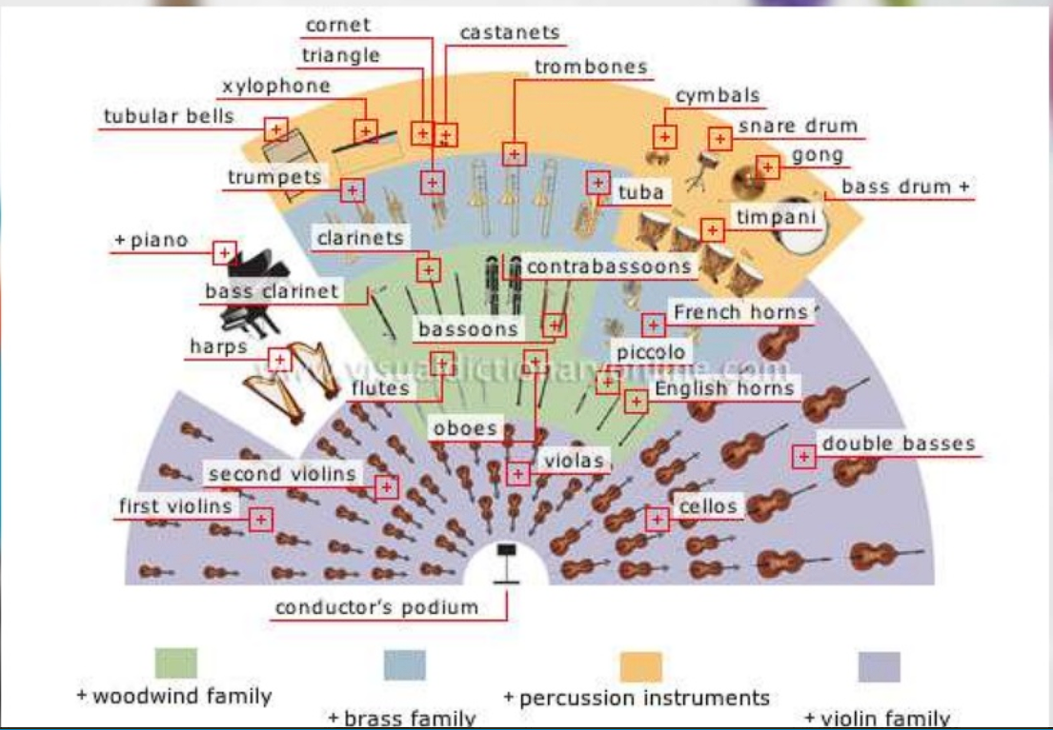
INSTRUMENT IN AN ORCHESTRA
https://www.youtube.com/watch?v=fd16sNr9T2Q

Slide 20
MUZIČKI INSTRUMENTI I MUZIČARI
Muzički instrumenti:
https://www.youtube.com/watch?v=-nzckoISaE4
Muzički instrumenti na srpskom jeziku:
https://www.youtube.com/watch?v=on2FOpWJpks
Nazivi muzičara:
https://www.youtube.com/watch?v=LhZ2N5KAWak

Slide 21
WORKSHEET
https://www.liveworksheets.com/worksheets/en/Music/Instruments/Instruments_it1393474kf
https://www.liveworksheets.com/worksheets/en/Music/Instruments/Identif_2%C2%BA_gp780223bn
https://www.liveworksheets.com/worksheets/en/Music/Instruments/Instrument_families_hm463417jp
https://www.liveworksheets.com/pq155530vq

Slide 22
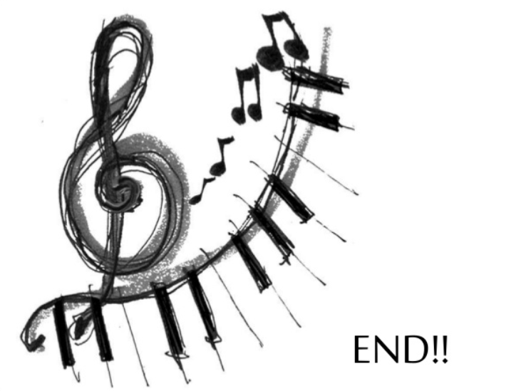
https://www.youtube.com/watch?v=mdFrn89x74k

Slide 23
